Slide 1
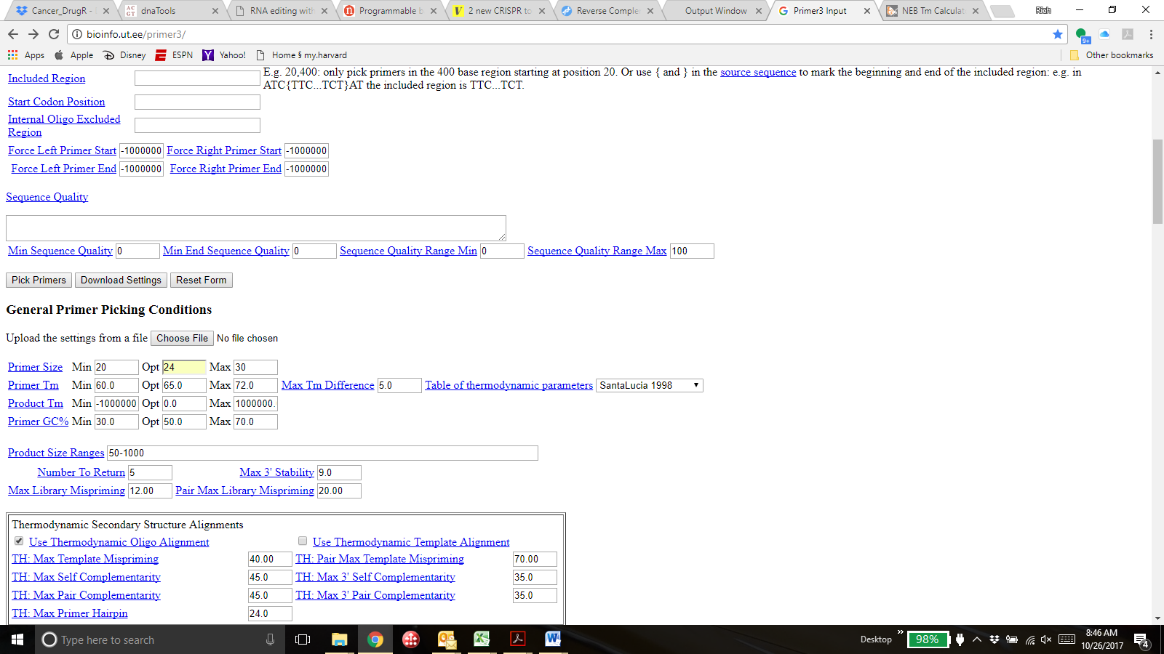
http://bioinfo.ut.ee/primer3/
19
22
28
58
61
65
50-150 (if no valid primers found, you can expand to max of 200 and then 250)
Use drop-down menu to select HUMAN mispriming library for human primers (use RODENT_AND_SIMPLE for mouse)
Change the values for the seven fields where I have written a different number. Keep all other values as default/blank. Order the 1 suggested primer pair per gene (Primer3 output already reverse complements the reverse primer, so no need to do so yourself)
If you want primers to span a particular sequence, use [] to specify the sequence you want to be included in amplicon. For CRISPR base edited sequences, bracket a 21-nt sequence centered on the edit site (10-nt on either side)

